Slide 1

Telcom Customer Churn
Lakhvir Singh

Slide 2
Introduction
Customer churn, also called customer attrition is the measure of how many customers stop using a product or service. This can be measured based on actual usage or failure to renew (when the product is sold using a subscription model). Often evaluated for a specific period of time, there can be a monthly, quarterly, or annual churn rate.
The Telco Customer Churn dataset includes information such as :-
customer demographics (age, gender, marital status, and dependents).
services availed (internet, phone, multiple lines, online security, and online backup).
account details (contract type, payment method, and tenure).
churn status (whether the customer has churned or not).

Slide 3
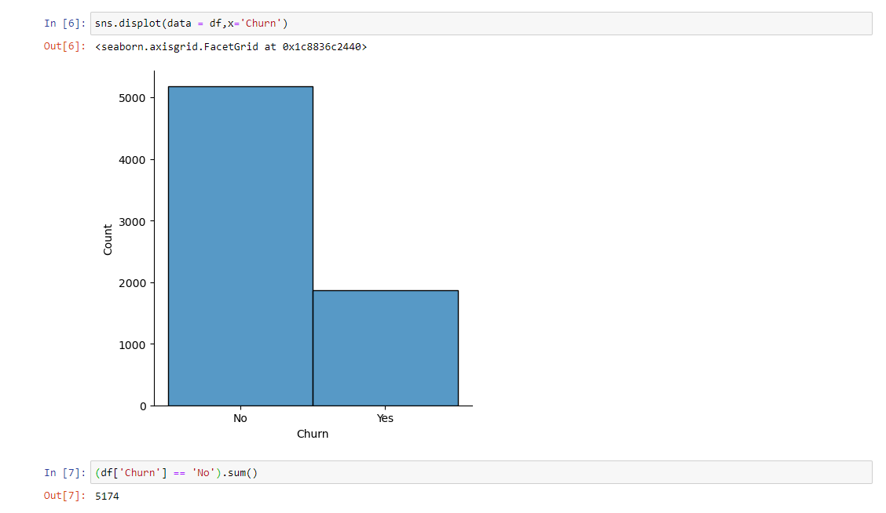
Analyzing Customer Retention Trends in Telecom

Slide 4
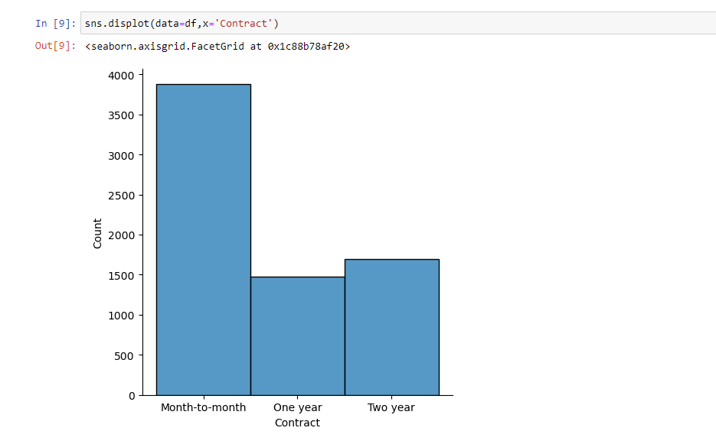
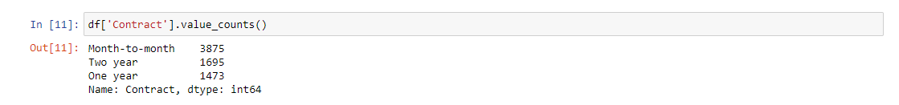
"What is the most common contract type chosen by customers?"

Slide 5
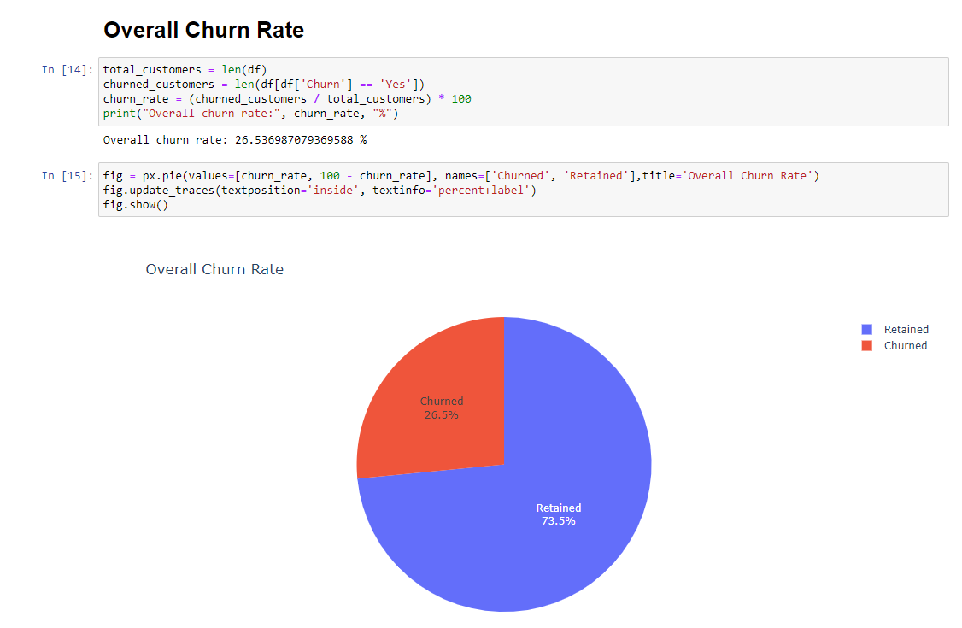

Slide 6
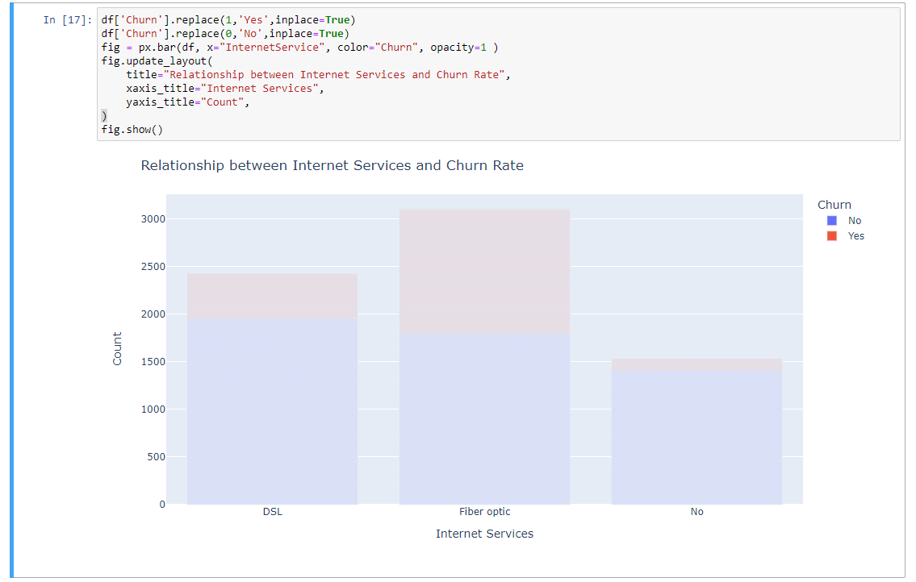
Relationship b/w internet services and churn rate

Slide 7
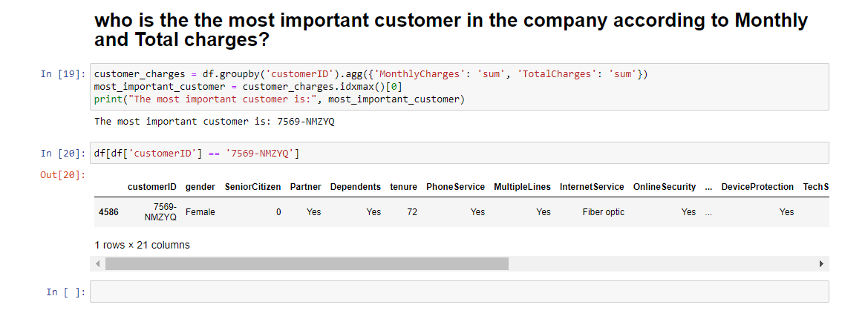
Company's key customer

Slide 8
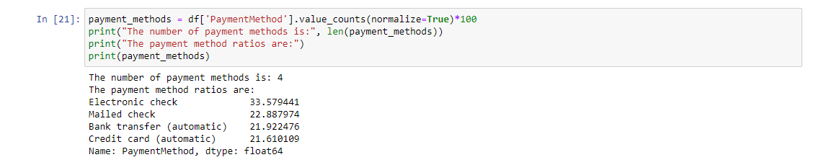
"Payment Method Diversity and Usage Ratio"

Slide 9
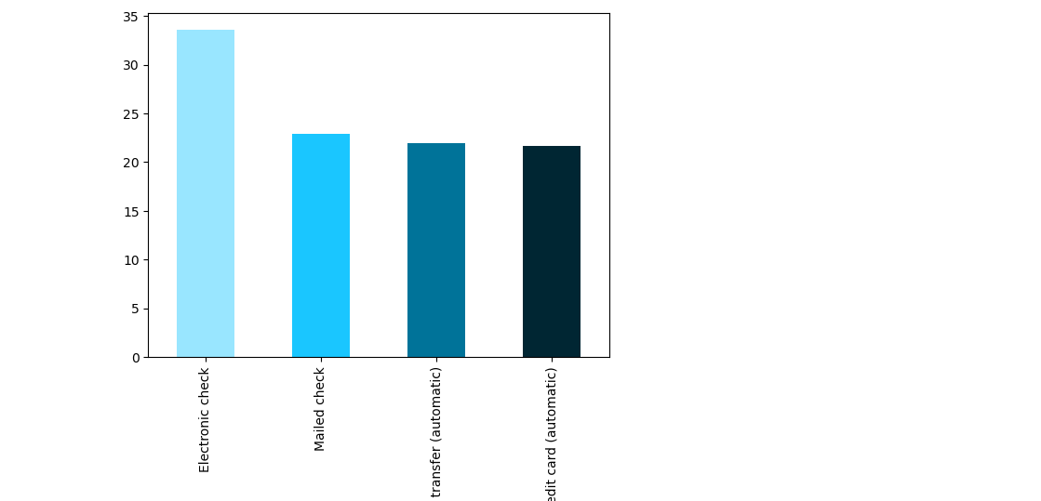

Slide 10
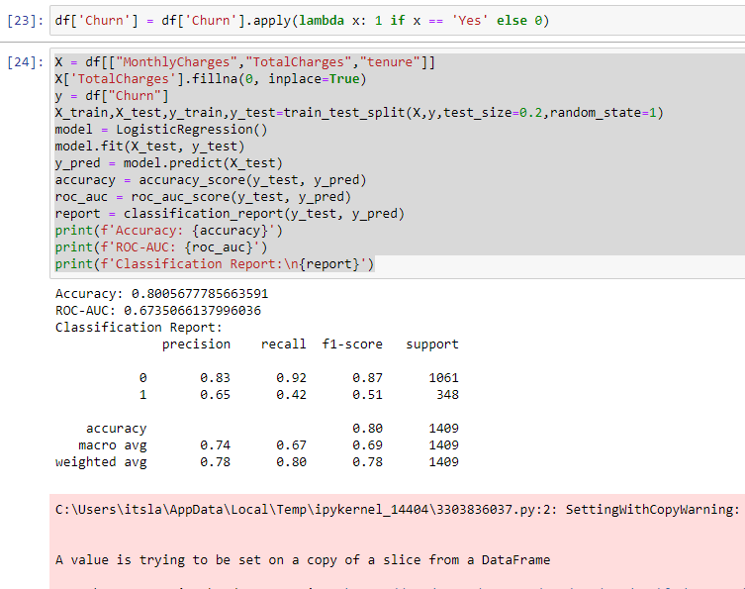
The binary classification model has an accuracy of 80.05%, indicating it correctly predicts class labels 80.05% of the time. The ROC-AUC score is 67.35%, suggesting decent discrimination ability. The precision, recall, and F1-score vary between the two classes, with class 0 having higher values, while class 1 lags behind.

Slide 11
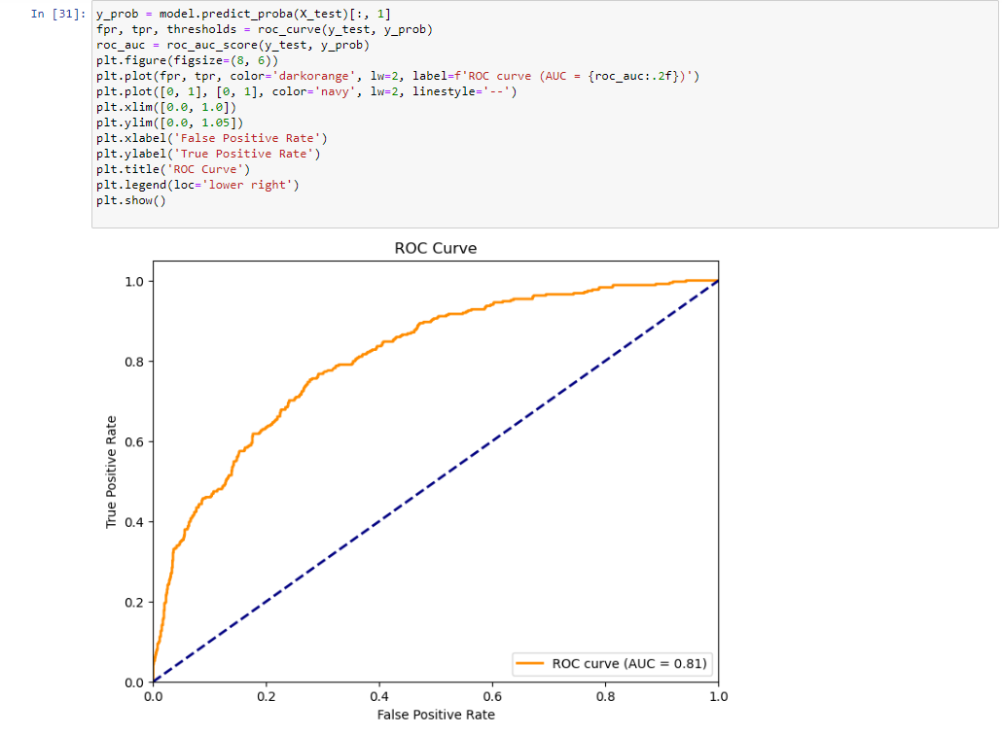
Roc Analysis

Slide 12

Thank You

